Slide 1
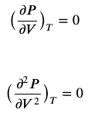




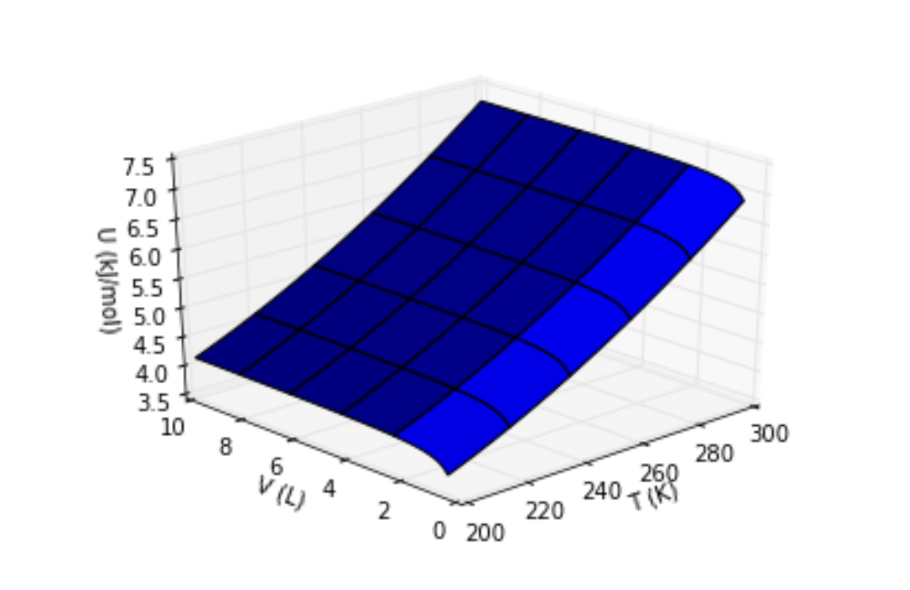
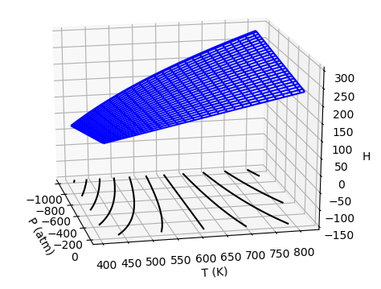
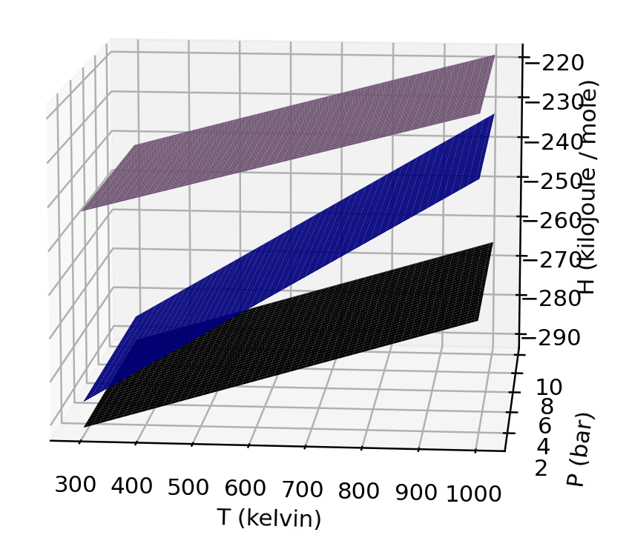
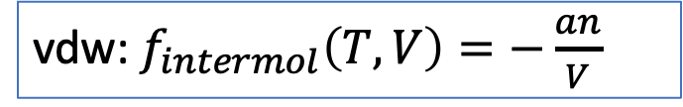

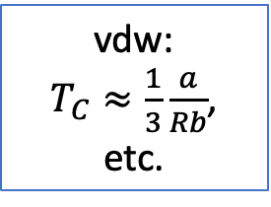



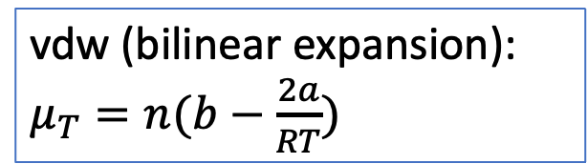
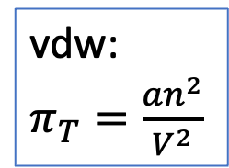
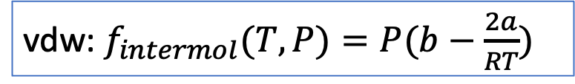
A roadmap of where we are in our understanding of Thermodynamics
vdw:
$T_{C}≈\frac{1}{3}\frac{a}{Rb}$, etc.
$P=P(T,V)$
vdw:
$π_{T}=\frac{an^{2}}{V^{2}}$
vdw (bilinear expansion): $μ_{T}=n(b−\frac{2a}{RT})$
vdw: $f_{intermol}\left(T,V\right)=−\frac{an}{V}$
vdw: $f_{intermol}(T,P)=P(b−\frac{2a}{RT})$
$$U(T,V)$$
$$H(T,P)$$
$$ΔH_{rxn}(T,P)$$

Slide 2
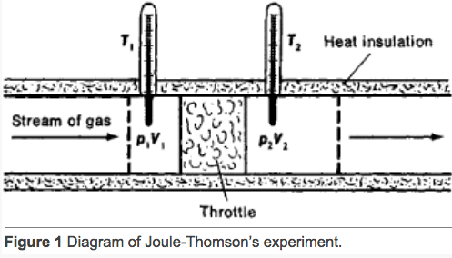
The Adiabatic Joule-Thomson experiment got us $\frac{∆T}{∆P}≡μ_{JT}$
A key feature of the Adiabatic Joule-Thomson experiment is that the gas follows an isenthalp (line of constant enthalpy) on its way out of the tank.
https://encyclopedia2.thefreedictionary.com/Joule-Thomson+Effect

Slide 3
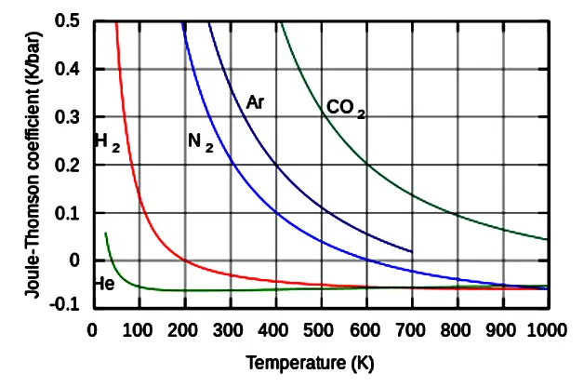

Literature values for $μ_{JT}$
https://cdn.instrumentationtools.com/wp-content/uploads/2019/01/Joule%E2%80%93Thomson-effect.png
For comparison, our result for $CO_{2}$:
$$μ_{JT}≈1\frac{K}{bar}$$

Slide 4

Using $μ_{JT}$to find $μ_{T}$
$$μ_{T}$$
$μ_{JT}$ is related to our friend ${{\left(\frac{∂H}{∂P}\right)}_{T}≡μ}_{T}$ (the Isothermal Joule-Thomson coefficient) by
$$μ_{T}=−C_{P}μ_{JT}$$
$$μ_{JT}$$

Slide 5
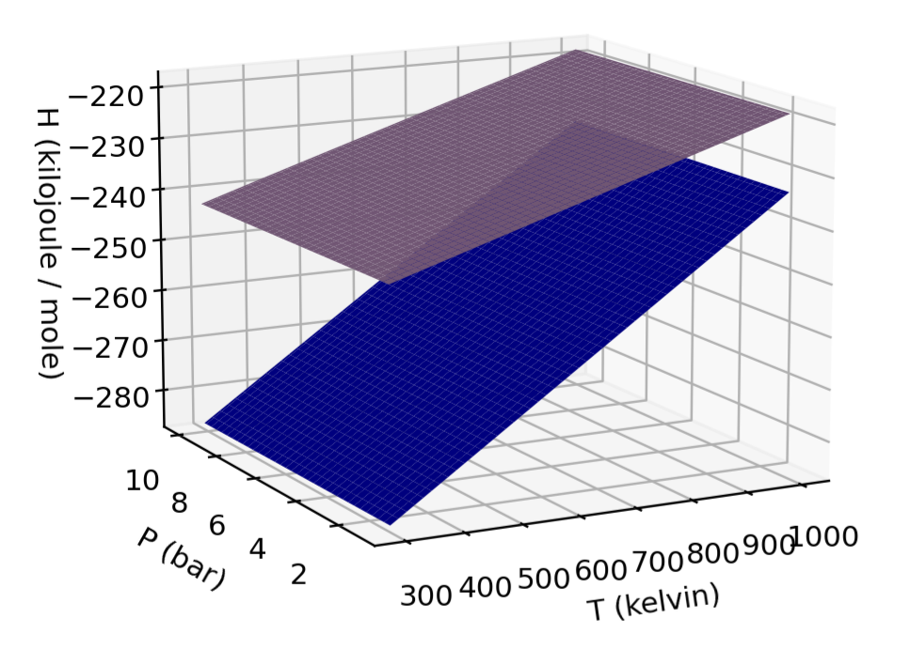
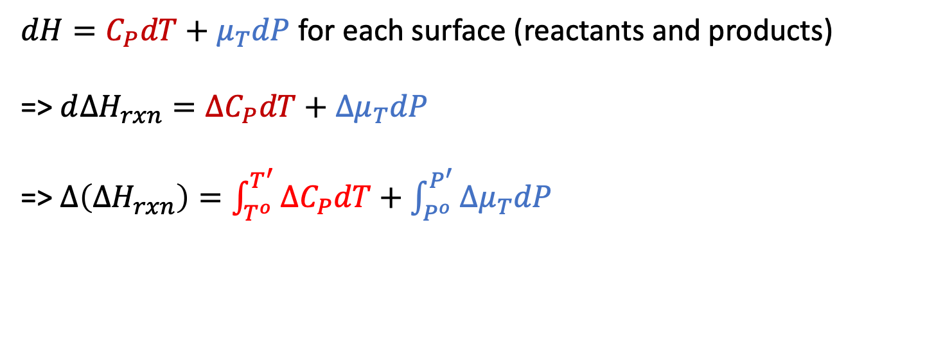




$∆H_{rxn}=∆H_{rxn}^{o}+∆\left(∆H_{rxn}\right)$
$dH=C_{P}dT+μ_{T}dP$ for each surface (reactants and products)
=> $d∆H_{rxn}=∆C_{P}dT+{∆μ}_{T}dP$
=> $∆\left(∆H_{rxn}\right)=\int_{T^{o}}^{T^{′}}{{∆C}_{P}dT}+\int_{P^{o}}^{P^{′}}{{∆μ}_{T}dP}$
${∆C}_{P}=C_{P}^{products}−C_{P}^{reactants}$
$$products$$
$$reactants$$
$${∆μ}_{T}=μ_{T}^{products}−μ_{T}^{reactants}$$

Slide 6
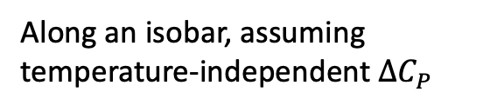
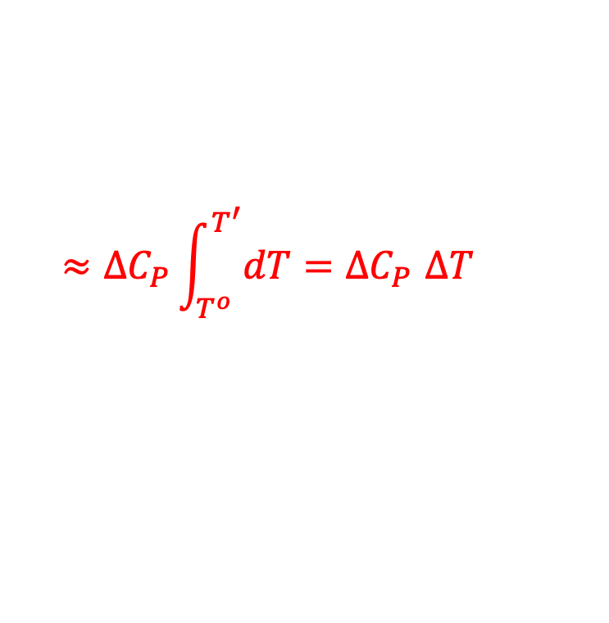
$∆H_{rxn}=∆H_{rxn}^{o}+∆\left(∆H_{rxn}\right)$
$dH=C_{P}dT+μ_{T}dP$ for each surface (reactants and products)
=> $d∆H_{rxn}=∆C_{P}dT+{∆μ}_{T}dP$
=> $∆\left(∆H_{rxn}\right)=\int_{T^{o}}^{T^{′}}{{∆C}_{P}dT}+\int_{P^{o}}^{P^{′}}{{∆μ}_{T}dP}$
${∆C}_{P}=C_{P}^{products}−C_{P}^{reactants}$
$$products$$
Along an isobar, assuming temperature-independent ${∆C}_{P}$
$$reactants$$
$$≈{∆C}_{P}\int_{T^{o}}^{T^{′}}{dT}{=∆C}_{P}∆T$$
“Kirchoff’s Law”
$${∆μ}_{T}=μ_{T}^{products}−μ_{T}^{reactants}$$

Slide 7
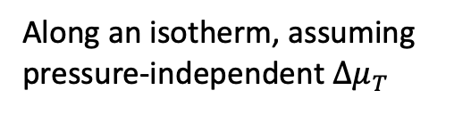
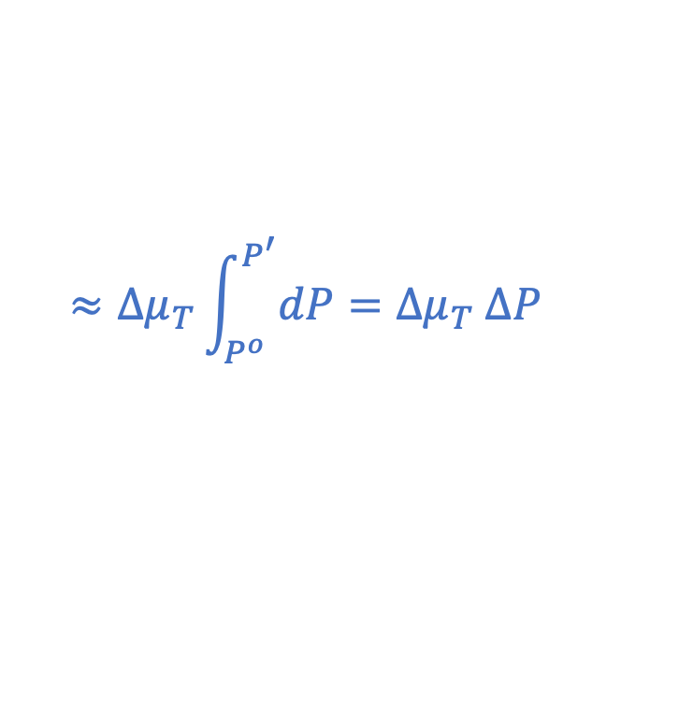
$∆H_{rxn}=∆H_{rxn}^{o}+∆\left(∆H_{rxn}\right)$
$dH=C_{P}dT+μ_{T}dP$ for each surface (reactants and products)
=> $d∆H_{rxn}=∆C_{P}dT+{∆μ}_{T}dP$
=> $∆\left(∆H_{rxn}\right)=\int_{T^{o}}^{T^{′}}{{∆C}_{P}dT}+\int_{P^{o}}^{P^{′}}{{∆μ}_{T}dP}$
${∆C}_{P}=C_{P}^{products}−C_{P}^{reactants}$
Along an isotherm, assuming pressure-independent $∆μ_{T}$
$$products$$
$$≈{∆μ}_{T}\int_{P^{o}}^{P^{′}}{dP}={∆μ}_{T} ∆P$$
$$reactants$$
$$≈{∆C}_{P}\int_{T^{o}}^{T^{′}}{dT}{=∆C}_{P}∆T$$
“Kirchoff’s Law”
$${∆μ}_{T}=μ_{T}^{products}−μ_{T}^{reactants}$$

Slide 8
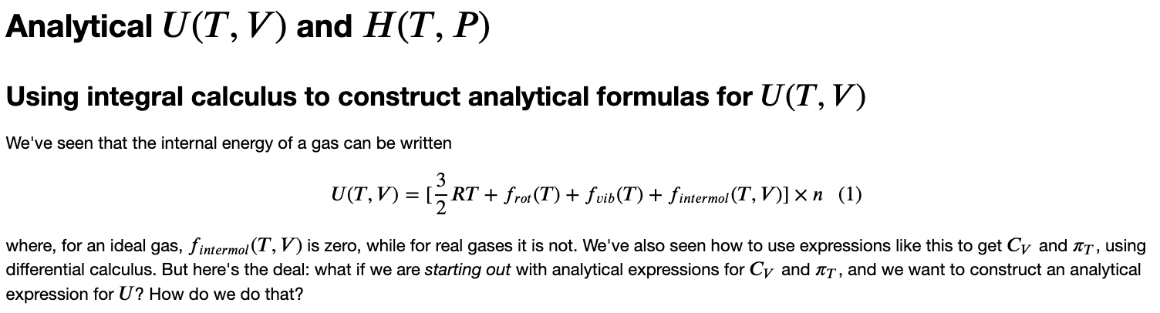
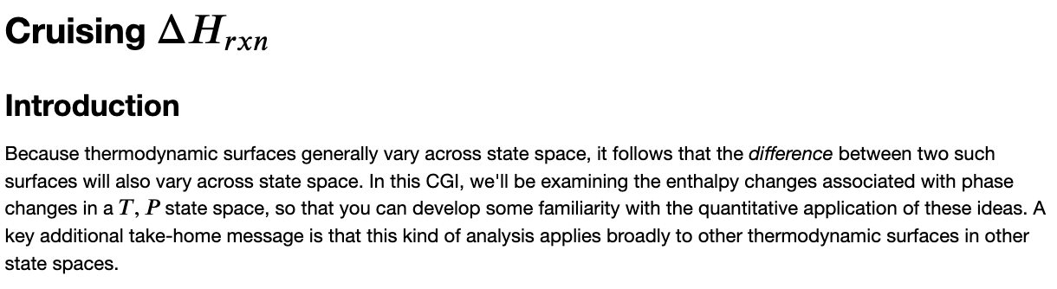
Wrapping up the Python work

